Slide 1
Analysing and Interpreting Financial Statements
Using Ratio Analysis to interpret financial performance

Slide 2
Financial ratio classifications
Categories
Profitability
Efficiency
Liquidity
Financial gearing
Investment.

Slide 3
Liquidity ratios
Current ratio
As well as profits, companies must have sufficient liquid resources
Assesses whether company could pay its bills over the next few months
Ratio of 2:1 often considered optimal
Varies greatly between industries e.g. supermarkets
Current assets
Current liabilities

Slide 4
High ratio may indicate
  Deliberate policy on part of management
  Too much money tied up in unproductive short term assets
Low ratio may indicate
  company is having problems paying its suppliers
  company is actively managing its working capital

Slide 5
Acid test ratio
Also known as ‘quick ratio’
Also looks at short term liquidity
Eliminates inventories, as this is considered least liquid asset
Ratio of less than 1:1 may suggest liquidity problems
Also varies between industries
Current assets – inventories
Current liabilities

Slide 6
Financial gearing ratios
Gearing occurs when a company is financed by loans as well as equity
Loan capital is a cheap source of finance for company, because of relatively low risk for lender
Increased loan capital increases risk to shareholders
  Interest paid regardless
  Lenders rank above shareholders in any winding-up
Various ratios to measure this risk

Slide 7
Gearing ratio
Measures relation between debt and equity finance
‘Long-term liabilities’ usually includes all forms of long-term loan capital, including debentures
‘Shareholders funds' refers to ordinary share capital and reserves
Any preference shares are usually included as part of loans
The more highly geared the company, the greater the risk that little will be available as dividends to the ordinary shareholders
Long-term liabilities x100
Shareholders funds + long-term liabilities

Slide 8
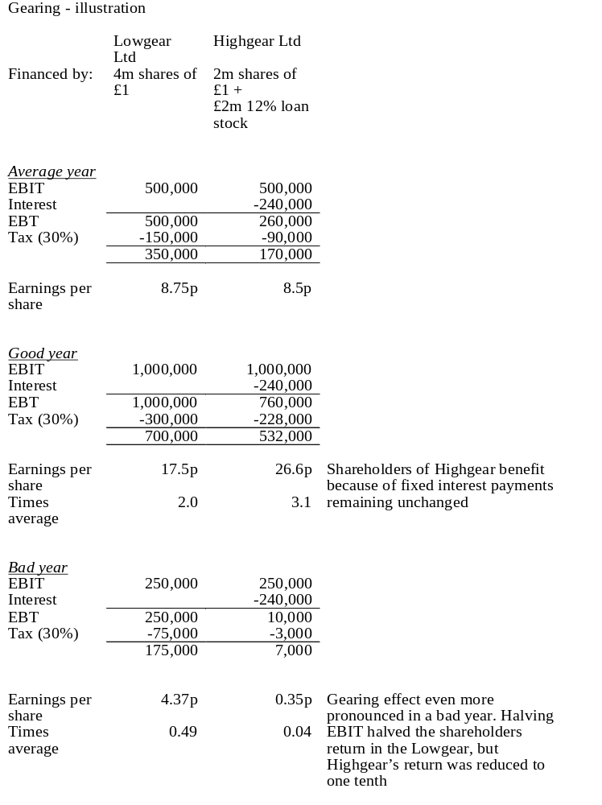

Slide 9
Interest cover
Measures number of times a company could pay its interest out of profit
The higher the multiple, the less likely the company will run into difficulty
Ideally cover interest 3 or 4 times
Note that different loan issues may have different priority over others for interest payments, depending on loan agreements
operating profit
interest payable

Slide 10
Asset Cover
Measures amount available to repay loans in event of a winding up.
Assumes intangible assets worthless
Loan with asset cover of less than 2 is usually considered high risk
Note calculation will vary if there are several types of loan (secured loan will rank for payment before unsecured loan.)
Total assets–intangible assets–current liabilities
loan capital

Slide 11
Dividend cover
Investment ratios
Profit for the year
Dividend for the year
Companies cannot maintain dividends if not covered by profits
High level of dividend cover implies more scope to increase dividends in the future
Example –
  Co A made profits of £10,000,
  Co B made profits of £30,000
  Both pay dividends of £5,000 per share.
  Which is safer?

Slide 12
Dividend Yield
Shows the amount of income (dividends) an investor receives per unit of investment (share price)
Low yield may mean:
  Share is overvalued
  Investors expect dividends to grow rapidly
  Note that this ratio ignores any potential capital gain
  (Ignore tax implications)
Dividend Yield = Dividends per share
Market price of share

Slide 13
Earnings per share
Amount of profit earned for each ordinary share
Trend over time can help assess the investment potential of a company’s shares
Profit for the year
Number of issued ordinary shares

Slide 14
Price/Earnings (P/E) Ratio
PER = Market value of a share
earnings per share
Measure of market confidence in the future of the business
Market price encapsulates everything known to the market about the company
Relating this to earnings gives an insight into the market’s opinion of the company’s performance
High PER – company considered attractive as a source of revenue (e.g. low risk investment, high future growth in earnings)

Slide 15
Limitations of ratio analysis
Quality of financial statements
  Adherence to accounting rules and conventions may result in accounts which are not useful for analysis
Comparisons between firms
  Different firms use different methods
    Valuation method for stock
    Depreciation method
    Revaluation of assets
    Intangible assets

Slide 16
Inflation
  With historical cost convention, it can be difficult to judge whether growth is real, or a result of inflation
  Overstates profits in times of high inflation eg
    Increase in inventory values:
    Depreciation too low (calculated on original cost of asset)
Item purchased for £1, sold for £1.50,
Profit recorded as 50p.
But if cost of replacing item is now £1.20, ‘real’ profit is only 30p.

Slide 17
Creative accounting
  Directors may want to manipulate accounts to enhance the business’ image – ‘window dressing’
  Most loopholes closed by accounting standards
  Possibilities remaining:
    Inappropriate depreciation of fixed assets
    Inappropriate valuation of stock
    Inappropriate valuation of future liabilities (eg pension provisions)
    Creating intangible fixed assets of questionable true worth
    Omitting contingent liabilities
    Pre-booking anticipated sales revenues

Slide 18
Out of date figures
  Figures may be based on transactions which occurred nearly two years earlier
Forecasting the future
  Cannot use historical data to accurately predict the future

Slide 19
Summary
Ratio analysis may be used to facilitate interpretation of financial performance.
Ratios are best used in conjunction with other ratios to understand the performance and reasons for changes in results.
Benchmarking is key to interpretation of financial performance.
Ratios enable comparisons between organisations of a different size.

